Slide 1
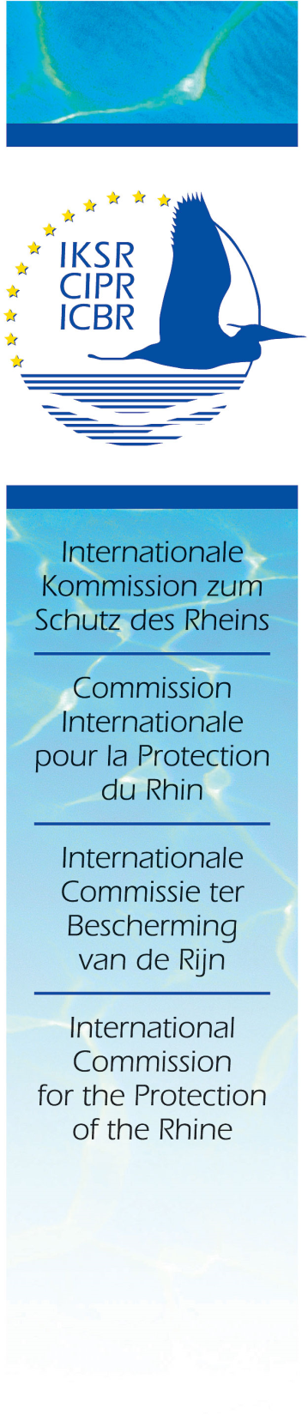
River Basin Management in the Rhine
Ben van de Wetering
Executive Secretary (Emeritus)

Slide 2

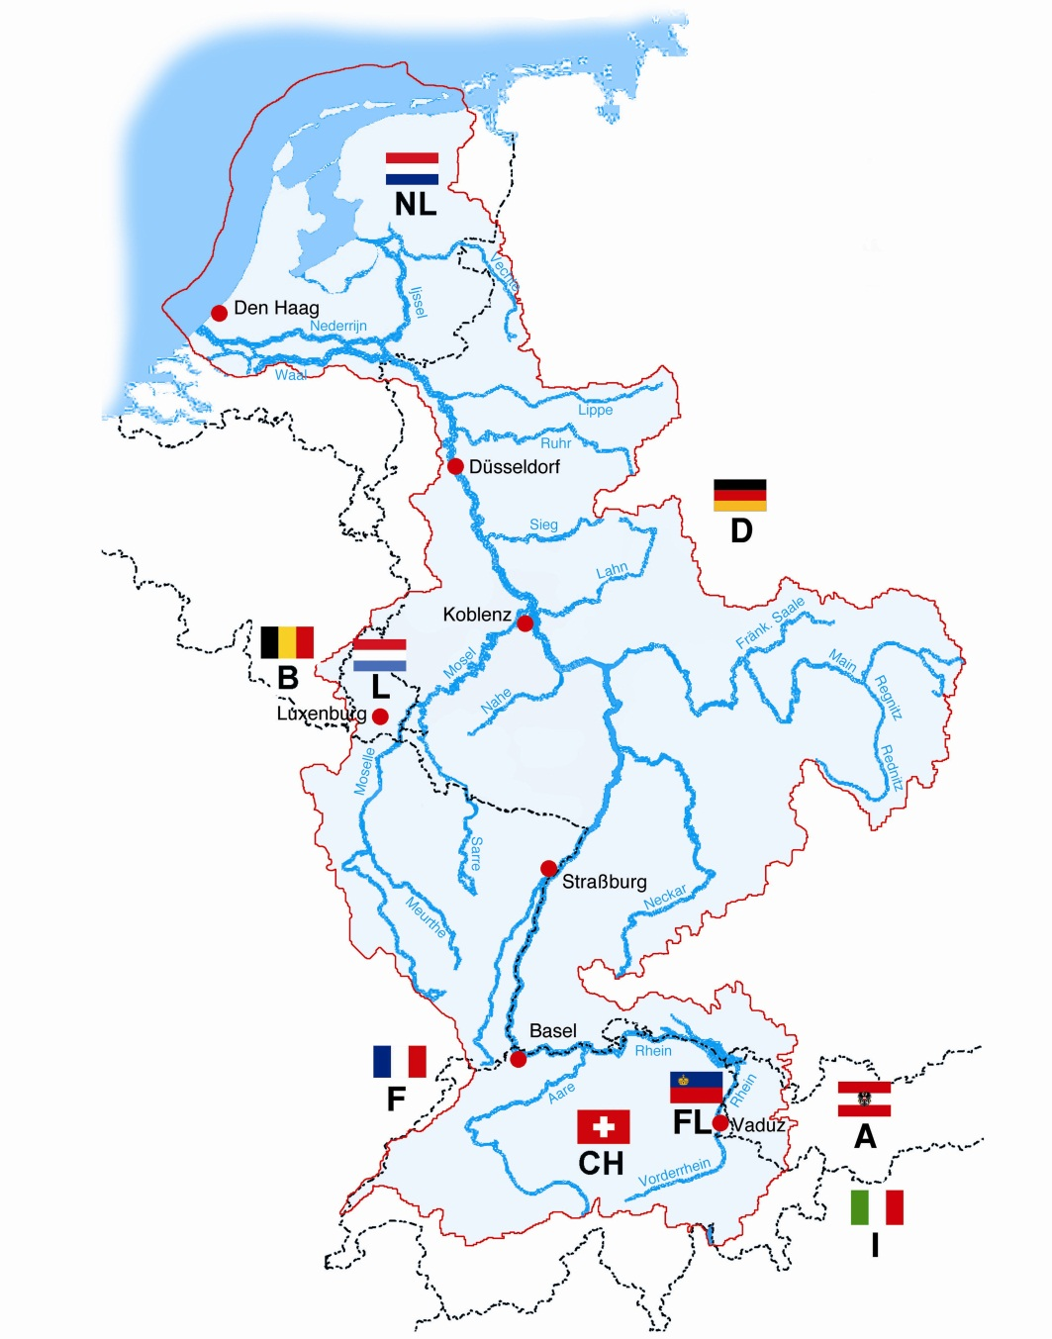
The Rhine - Catchment area
3rd biggest European river
9 countries,
58 million Inhabitants
Drinking water supply for 30 million people

Slide 3

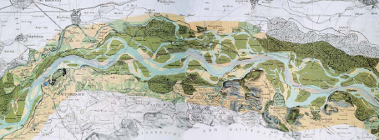
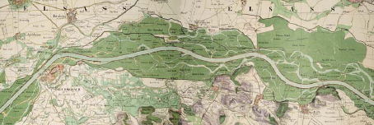
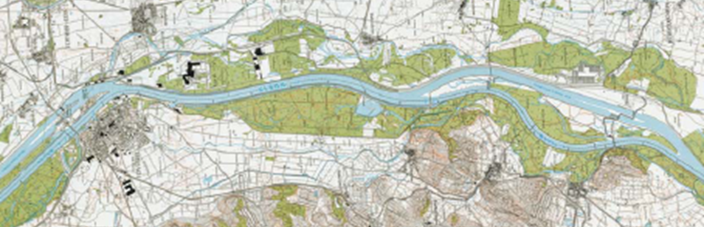
Changes over the centuries
1838
1872
1980
Over the years: 85% loss of alluvial flood areas

Slide 4
ICPR - Landmarks
1950 – Foundation
People in the Netherlands were suffering from the very poor quality of the Rhine as source for their drinking water and for use in agriculture
Supported by Switzerland (which was neutral during WWII), the Netherlands initiated the first meeting of the ICPR on 11 July 1950

Slide 5
50ties - 70ties of the 20th Century
First activities
The first meeting resulted in agreements related to the
  analysis water pollution
  harmonisation of monitoring programmes and methods
  exchange of monitoring data
  development of water protection measures
This was followed by a period with
  building trust and mutual understanding
  detailed technical discussion on best available technologies for reducing water pollution, agreed upon in the form of recommendations to the Contracting Parties
In 1963, the first Rhine Convention was agreed upon followed in 1967 by a Convention for dealing with chemical pollution
But water quality did not really improve

Slide 6
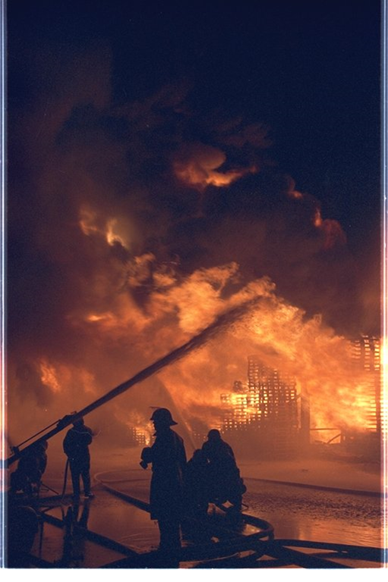
01 November 1986
A major disaster was a turning point
10-30 tons of highly toxic pesticides flowed into the river
causing the death of all aquatic life downstream (e.g. eel for 400 km)

Slide 7
Political Courage and Ambition
The Sandoz Disaster happened in a period in which environment received strong public and political support. It resulted in a recognition that
there was a joint problem to be solved
there was more than chemical quality to improve
there was a need for a shift from short term detailed technical discussion to long term ambitious goal setting
Within a year with three meetings at ministerial level the Rhine Action Programme was agreed upon with the return of the Salmon as a flagship combined with the political ambition for a substantial reduction of inputs of substances

Slide 8
The Rhine Action Programme
Its target was to improve water quality to such an extent that formerly indigenous species, such as salmon, would be able to return to the river.
At the same time, the entire ecosystem had to be improved and flora and fauna were to be strengthened
A consequence, requirements concerning municipal and industrial wastewater treatment plants became distinctly more strict and a third treatment stage was introduced to eliminate phosphorous and nitrates
In addition, industry joint in and accepted its responsibility.
The first survey in 1992 already gave evidence of a considerable reduction of pollutants

Slide 9
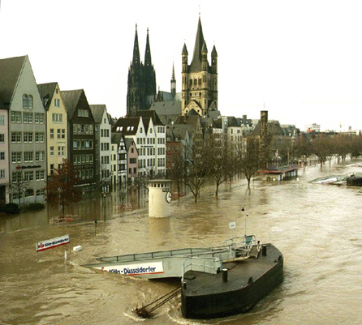
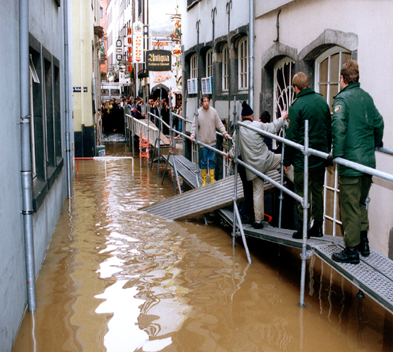
The Flood Action Plan
During Christmas 1993 and in January/February 1995, disastrous flood events occurred
As a reaction, the ICPR adopted a Flood Action Plan in 1998
Following that, a comprehensive international water management programme – Rhine 2020 - was developed, integrating qualitative and quantitative aspects of surface waters and groundwater
All new and additional targets were integrated into the new 1999 Rhine Convention

Slide 10
The 1999 Rhine Convention
Contracting Parties:
  Switzerland, France, Germany, Luxemburg, Netherlands, European Union
Cooperation within the river basin with:
  Austria, Liechtenstein, Wallonia (Belgium)
Observers:
  Intergovernmental Organizations (IGO's)
  Non-Governmental Organizations (NGO's)

Slide 11
The 1999 Rhine Convention
Scope
the Rhine itself
ground water interacting with the Rhine
aquatic and terrestrial ecosystems which interact or could again interact with the Rhine
the Rhine catchment area, insofar as
  its pollution by noxious substances adversely affects the Rhine
  it is of importance for flood prevention and protection along the Rhine

Slide 12
The 1999 Rhine Convention
Aims
Sustainable development of the Rhine ecosystem, in particular through, inter alia:
  maintaining and improving water quality
  protecting populations of organisms and species diversity
  maintaining, improving and restoring the natural function of the waters
  ensuring environmentally sound and rational management of water resources
Securing the production of drinking water from the waters of the Rhine
General flood prevention and protection, taking account of ecological requirements
To help restore the North Sea in conjunction with the other actions taken to protect it

Slide 13
The 1999 Rhine Convention
Main tasks of Contracting Parties
to step up their cooperation and to report on actions taken
to carry out monitoring programmes and specific studies agreed upon by the Commission
to identify causes of and parties responsible for pollution
to initiate autonomous actions deemed necessary to protect the Rhine
to take action in the event of incidents or accidents in accordance with the warning and alert plans coordinated by the Commission

Slide 14
The 1999 Rhine Convention
Mains tasks of the Commission
prepare international monitoring programmes and studies and make use of their results
make proposals for individual measures and programmes of measures
coordinate the Contracting States’ warning and alert plans for the Rhine
evaluate the effectiveness of agreed actions
inform the public as to the state of the Rhine and the results of its work

Slide 15
Cooperation
De-centralised independent organization
Delegations
  work with a political mandate
  do have the technical know how
  provide the common budget (1.200.000 €/a for operational costs of the Secretariat only)
Small neutral Secretariat, 4 languages
Political framework, no sanctions
Legal framework provided by EU Directives (WFD and FD) and national legislation
All agreements by consensus. Measures as recommendations to countries
Obligation to report on implementation of measures

Slide 16
The 1999 Rhine Convention
Conclusions
The Convention does not provide the ICPR with any power to adopt binding agreements nor to enforce implementation thereof
these powers are in fact provided for in national and EU legislation
However, work in the ICPR started already in 1950 and developed into a very successful cooperation without such powerful instruments
In addition, the work of the ICPR was one of the cornerstones of todays EU – water legislation

Slide 17
Challenges and Lessons learn
First Phase (50ties - 70ties twentieth-century)
Building trust and mutual understanding
Developing harmonised monitoring and data exchange
Convincing society of the danger of continuous increasing water pollution
Turning Point: Sandoz Accident
From short term detailed technical discussion to long term ambitious goal setting
Integration of all relevant policy fields
Challenges for the future
How correct the impact of missing environmental management of the past
How to take account of uncertainties regarding the socioeconomic evolution and the impact of climate change

Slide 18
Challenges and Lessons learned
Both the Sandoz fire in 1986 and the floods of 1993 and 1995 were triggers for fundamental changes in policy
a positive approach should be the core of all activities, even when catastrophic events have occurred
focus on building common denominators, not on identifying disagreements
To increase ownership, agreements should be developed
bottom-up with involvement of all stakeholders
in line with top-down (political) objectives

Slide 19
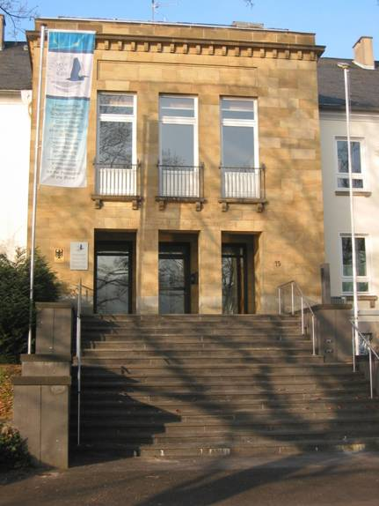
Thank you
www.iksr.org

